Slide 1
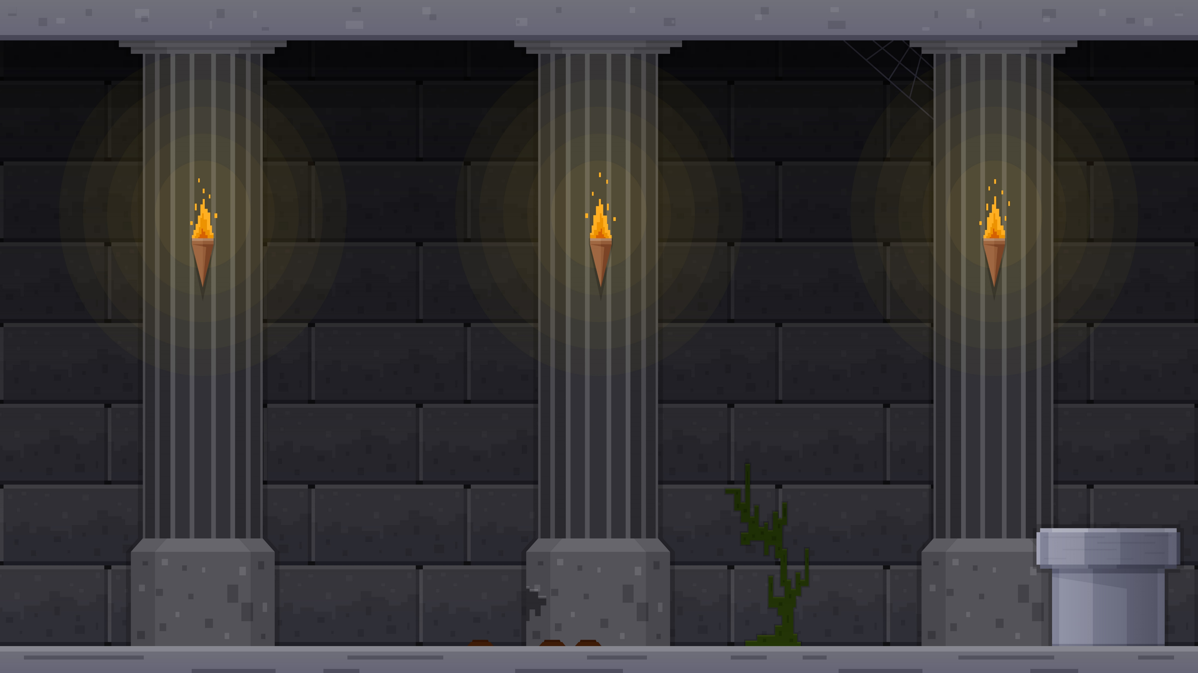

TO DO QUEST
START YOUR OWN QUEST
B877005 Kim Wanil
miricanvas.com

Slide 2

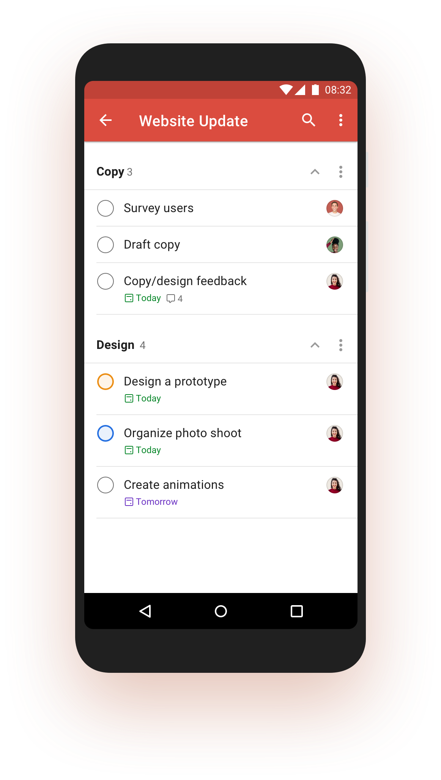

App overview
타이틀 입력
To do list App + Gamification
타이틀 입력
+
Quest system in RPG

Slide 3



App description
타이틀 입력
(Dungeon)
(Character)
(Monster)
To do a task = A Quest to kill the monster
Finish the task = Complete the quest

Slide 4
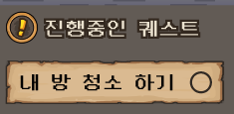
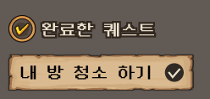
App description
Add a task
finish the task
타이틀 입력
(Character)
(Monster)

Slide 5

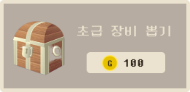

App description
타이틀 입력
Finishing the task (Killing monsters) -> Gain EXP and GOLD
타이틀 입력
Equipment gacha using GOLD -> Change character’s appearance

Slide 6


App description
타이틀 입력
The higher the character's level
타이틀 입력
->the more powerful monsters appear
->the more reward the player gets

Slide 7
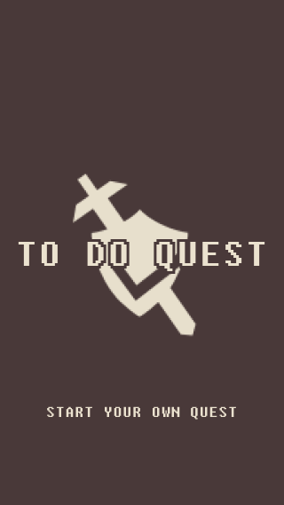
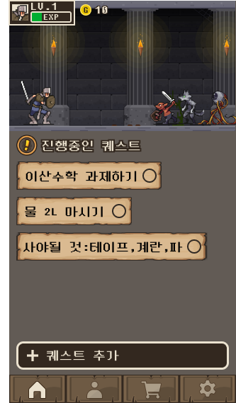
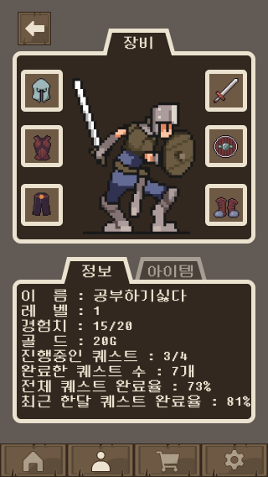
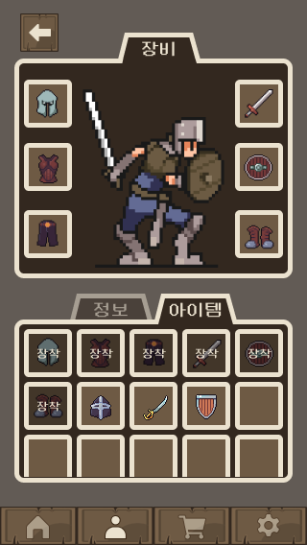
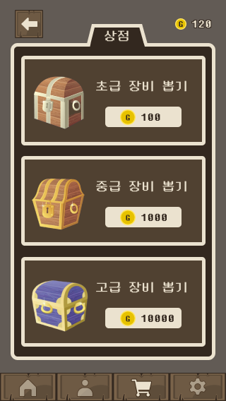
App screen
타이틀 입력
타이틀 입력
Title screen
Main screen
My screen
Inventory screen
Shop screen

Slide 8
타이틀 입력
타이틀 입력
Thanks to watching

